Slide 1
Secure Data Hiding in Image Using Steganography
CAPSTONE PROJECT
Presented By:
Garapati Prem Kumar
Gayatri Vidya Parishad College for Degree & PG Courses (A)
Computer Science Engineering Department

Slide 2
OUTLINE
Problem Statement
Technology used
Wow factor
End users
Result
Conclusion
Git-hub Link
Future scope

Slide 3
Problem Statement
Traditional data transmission methods are vulnerable to interception, leading to security risks. This project focuses on securely hiding sensitive data within images using steganography techniques. By embedding information in image pixels, the data remains undetectable to unauthorized users. The goal is to develop an efficient and robust method for secure data concealment while ensuring minimal distortion in image quality.

Slide 4
Technology used
Programming Language:
Python
Libraries:
OpenCV (cv2) – for image processing
NumPy – For handling image arrays
Tkinter – GUI (optional)
PIL (pillow) – For image handling (if needed)
Platforms:
Windows (For running the application)
VS Code (For development)

Slide 5
Wow factors
Enhanced Security
Uses Steganography + Encryption for double-layer protection.
Harder for attackers to extract hidden data.
Invisible to the Human Eye
Uses Least Significant Bit (LSB) Steganography to hide data.
No noticeable change in image quality.
Customizable & Scalable
Supports multiple formats (PNG, JPG, BMP).
Can be expanded for larger data hiding.
User-Friendly Interface
Simple GUI using Tkinter for easy encoding & decoding.
No complex coding required for users.
Anti-Detection Mechanism
Can integrate Random Pixel Embedding or Noise Addition.
Prevents steganalysis (detection attacks).

Slide 6
End users
Cybersecurity Professionals
Use steganography for secure communication and data protection.
Government & Intelligence Agencies
Hide sensitive information in images to prevent cyber espionage.
Corporate Organisations
Secure business data from hackers and unauthorised access.
General Users & Privacy Enthusiasts
Protect personal information from cyber threats and surveillance.

Slide 7
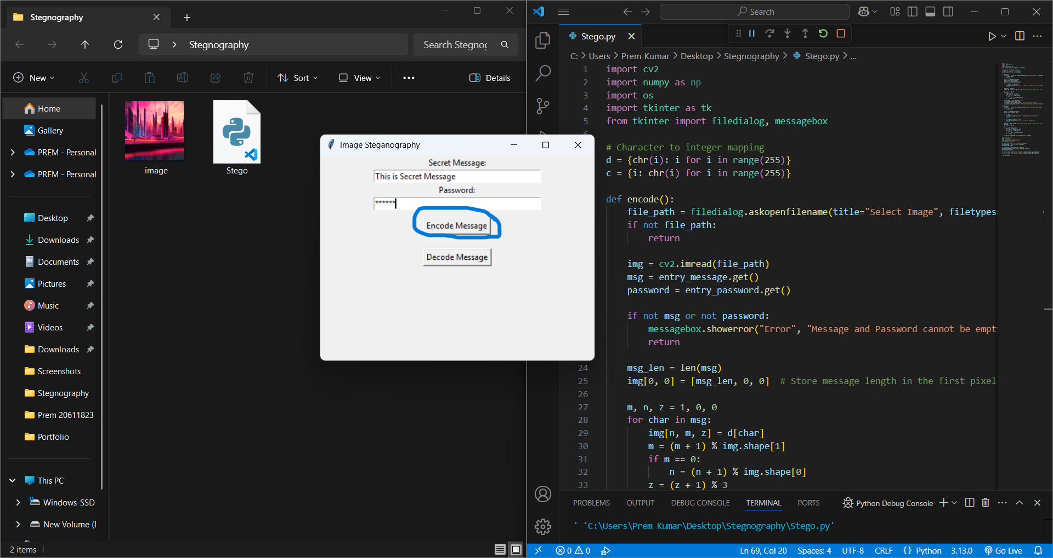
Results
Figure 1. Running the program and entering secret message and password in GUI to encrypt i.e., Encode Message.

Slide 8
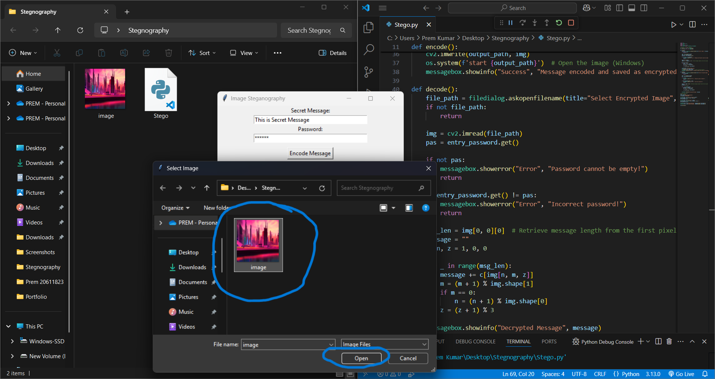
Figure 2. Selecting an image to encrypt the secret message within it.

Slide 9
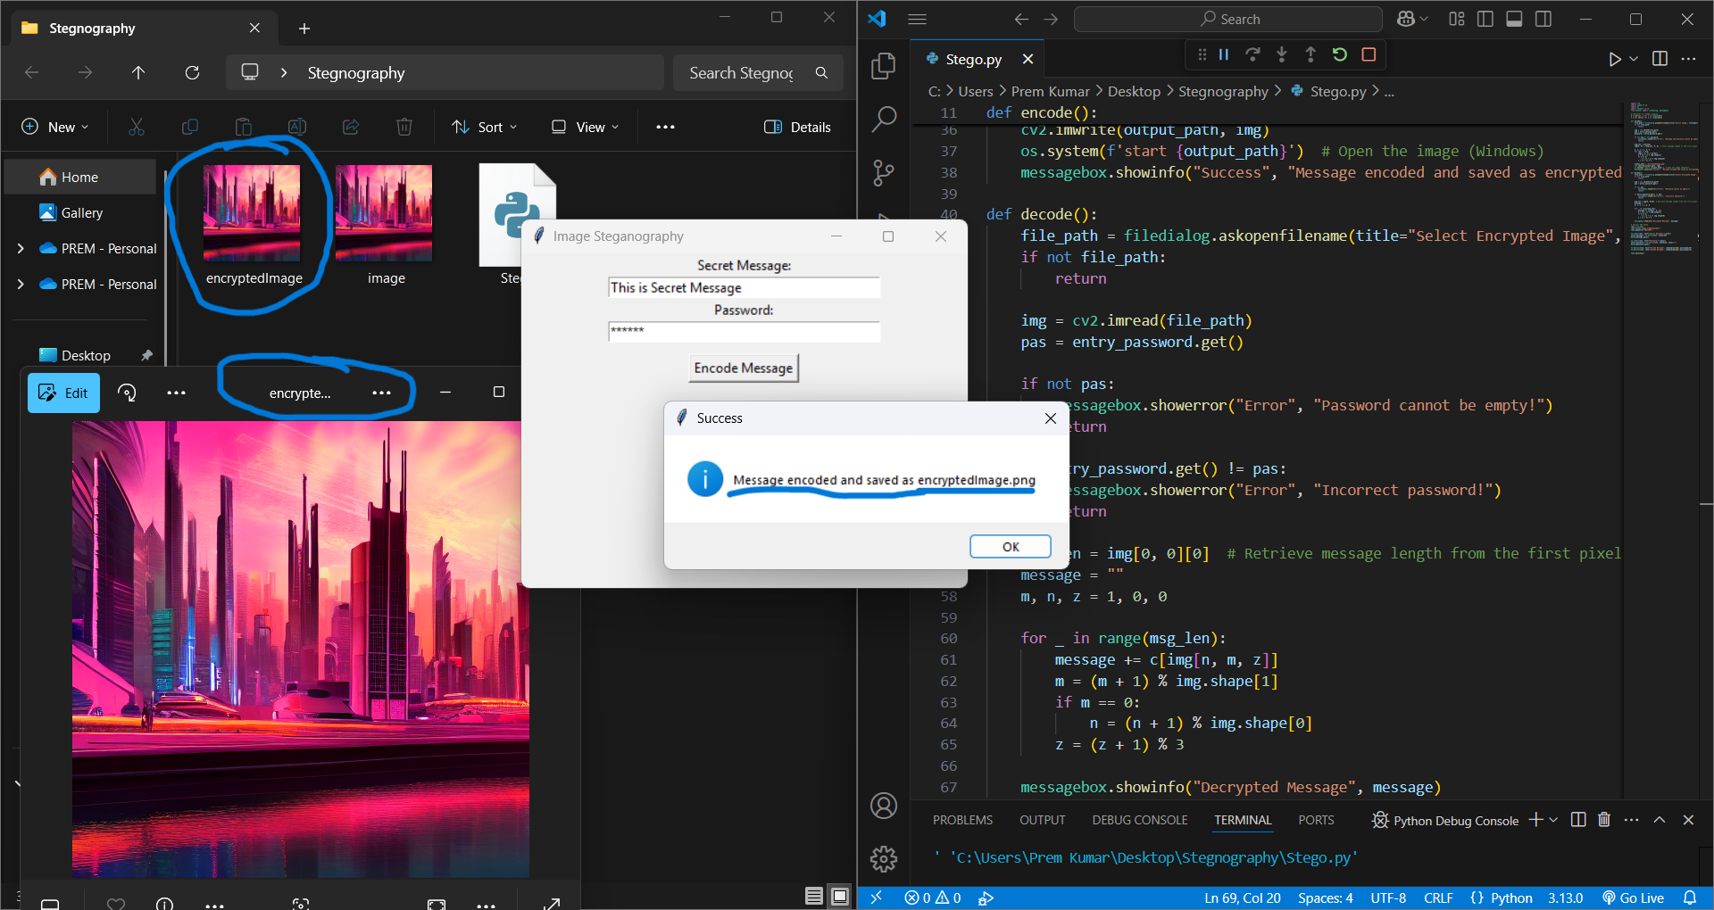
Figure 3. The secret message encrypted in a copy of that image named encryptedImage.png

Slide 10
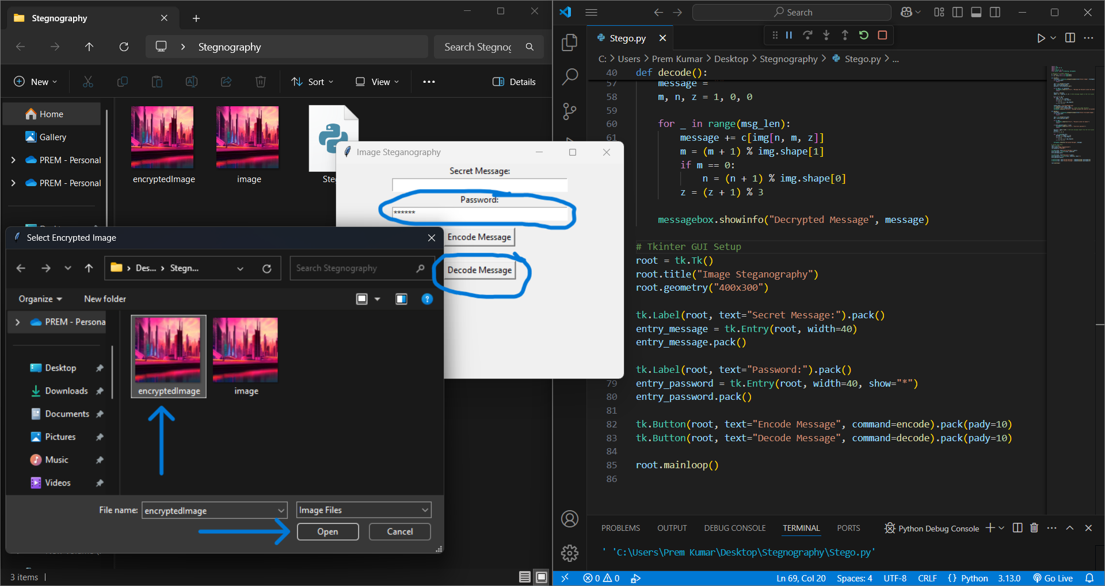
Figure 4. Decrypting by Decode Message button with same password and selecting the encryptedImage.png

Slide 11
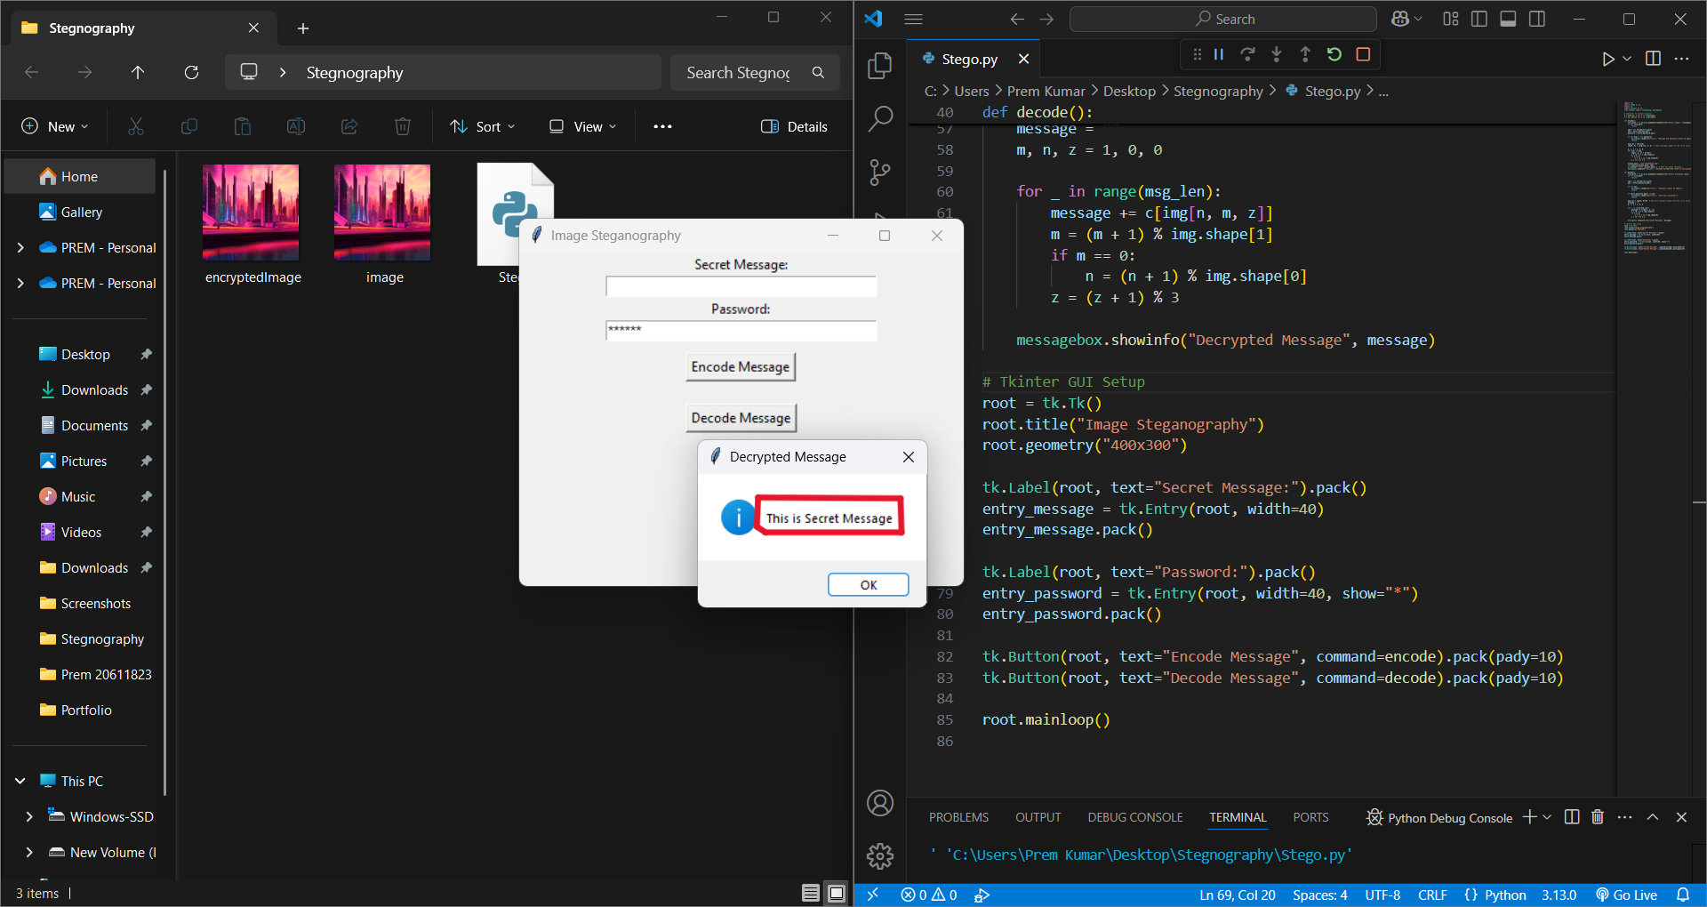
Figure 5. Result, Decrypted secret message displayed with a dialogue box.

Slide 12
Conclusion
This project successfully addresses the challenge of secure data transmission by implementing image steganography. By embedding sensitive information within image pixels, the data remains hidden from unauthorized users while maintaining image quality. The combination of LSB Steganography and Encryption enhances security, making it difficult for attackers to extract the concealed message. This approach ensures a reliable, undetectable, and user-friendly method for confidential communication, benefiting various sectors such as cybersecurity, government agencies, and corporate organizations.

Slide 13
GitHub Link
https://github.com/Search-Prem/Steganography.git

Slide 14
Future scope(optional)
Cloud Integration – Develop a cloud-based steganography tool for remote secure data hiding.
Blockchain for Security – Utilize blockchain technology to enhance data integrity and prevent tampering.
Real-time Applications – Extend the project for real-time secure messaging and live streaming.
Cross-Platform Compatibility – Develop mobile and web-based versions for broader accessibility.
Multi-Layered Encryption – Integrate multiple encryption algorithms for higher security levels.

Slide 15
THANK YOU

